Slide 1
Dataset Distillation
DATASET DISTILLATION
· Dataset Distillation(2018)
·Dataset Condensation with Gradient Matching(2021)
·Dataset Condensation with Distribution Matching(2023)
2024 – 09 - 20 SX2416069 Yangsong Lan
Notes:
任务本身是什么，任务的输入输出，目标是？难点是？

Slide 2
Dataset Distillation
Abstract
Model distillation aims to distill the knowledge of a complex model into a simpler one. In this paper, we consider an alternative formulation called dataset distillation: we keep the model fixed and instead attempt to distill the knowledge from a large training dataset into a small one. The idea is to synthesize a small number of data points that do not need to come from the correct data distribution, but will, when given to the learning algorithm as training data, approximate the model trained on the original data. For example, we show that it is possible to compress 60, 000 MNIST training images into just 10 synthetic distilled images (one per class) and achieve close to original performance with only a few gradient descent steps, given a fixed network initialization. We evaluate our method in various initialization settings and with different learning objectives. Experiments on multiple datasets show the advantage of our approach compared to alternative methods.

Slide 3
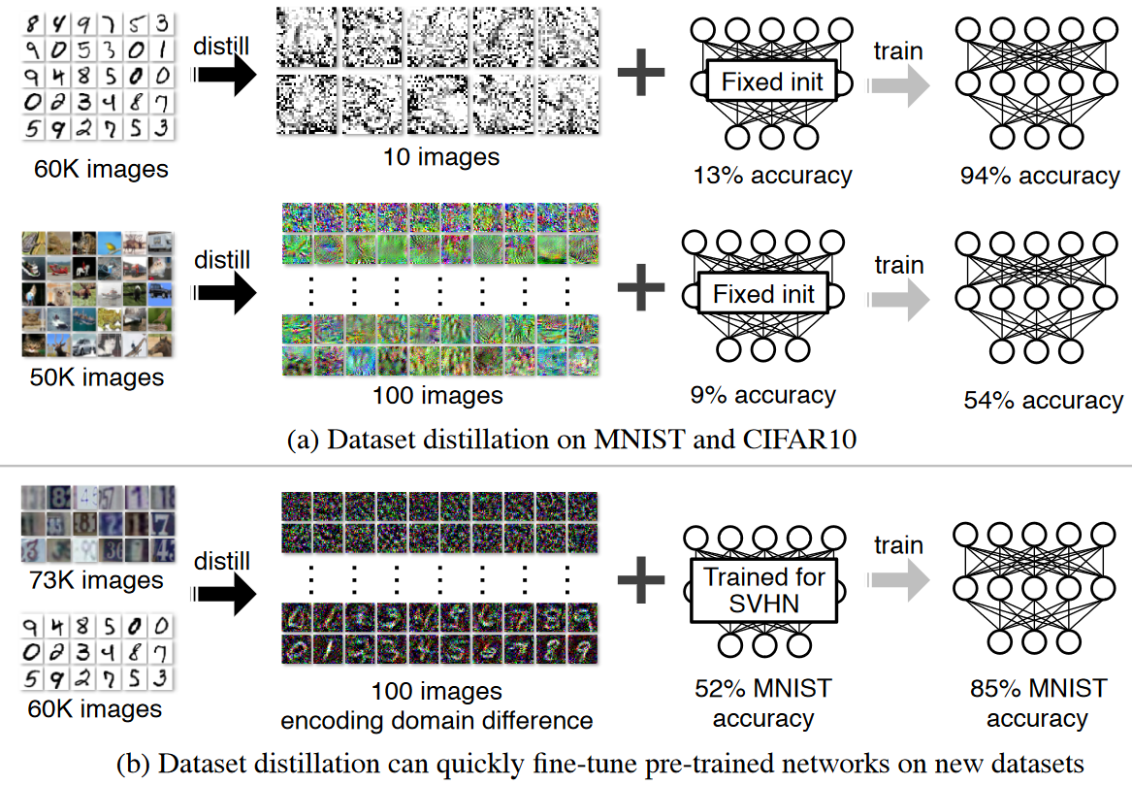
Dataset Distillation

Slide 4
Dataset Distillation
Introduction
But why is dataset distillation useful? There is the purely scientific question of how much data is encoded in a given training set and how compressible it is? Moreover, given a few distilled images, we can now “load up" a given network with an entire dataset-worth of knowledge much more efficiently, compared to traditional training that often uses tens of thousands of gradient descent steps.
A key question is whether it is even possible to compress a dataset into a small set of synthetic data samples. For example, is it possible to train an image classification model on synthetic images out of the manifold of natural images? Conventional wisdom would suggest that the answer is no, as the synthetic training data may not follow the same distribution of the real test data. Yet, in this work we show that this is indeed possible. We present a new optimization algorithm for synthesizing a small number of synthetic data samples not only capturing much of the original training data but also tailored explicitly for fast model training in only a few gradient steps.

Slide 5
Dataset Distillation
Background & Related Work
Knowledge distillation: A widely used technique in ensemble learning and model compression.
Dataset pruning, core-set construction, and instance selection：Another way to distill knowledge is to summarize the entire dataset by a small subset, either by only using the “valuable” data for model training or by only labeling the “valuable” data via active learning.
Gradient-based hyperparameter optimization: Our work bears similarity with gradient-based hyperparameter optimization techniques, which compute the gradient of hyperparameter w.r.t. the final validation loss by reversing the entire training procedure.
Understanding datasets: Analyzing training datasets has, in the past, been mainly focused on the investigation of bias in datasets.For example, Torralba & Efros (2011) proposed to quantify the “value” of dataset samples using cross-dataset generalization.

Slide 6
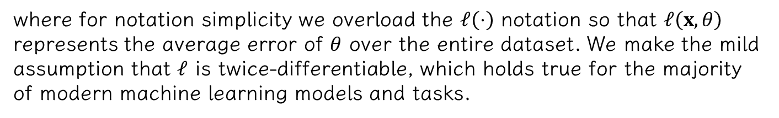
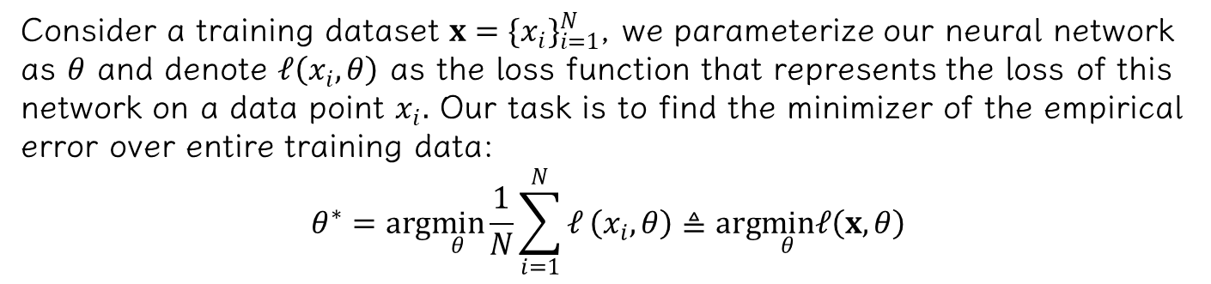
Dataset Distillation
Method
Given a model and a dataset, we aim to obtain a new, much-reduced synthetic dataset which performs almost as well as the original dataset.
Consider a training dataset $x=\{x_{i}\}_{i=1}^{N}$, we parameterize our neural network as $θ$ and denote $𝓁\left(x_{i},θ\right)$ as the loss function that represents the loss of this network on a data point $x_{i}.$ Our task is to find the minimizer of the empirical error over entire training data:
$$θ^{∗}=arg\min_{θ}\frac{1}{N}\sum_{i=1}^{N}{𝓁}\left(x_{i},θ\right)≜arg\min_{θ}𝓁\left(x,θ\right)$$
where for notation simplicity we overload the $𝓁\left(⋅\right)$ notation so that $𝓁\left(x,θ\right)$ represents the average error of $θ$ over the entire dataset. We make the mild assumption that $𝓁$ is twice-differentiable, which holds true for the majority of modern machine learning models and tasks.

Slide 7

Dataset Distillation
Method
Standard training usually applies minibatch stochastic gradient descent or its variants. At each step $t$, a minibatch of training data $x_{t}=\{x_{t,j}\}_{j=1}^{n}$ is sampled to update the current parameters as
$$θ_{t+1}=θ_{t}−η∇_{θ_{t}}𝓁\left(x_{t},θ_{t}\right),$$
where $η$ is the learning rate. Such a training process often takes tens of thousands or even millions of update steps to converge. Instead, we aim to learn a tiny set of synthetic distilled training data $\tilde{x}=\{{\tilde{x}}_{i}\}_{i=1}^{M}$ with $M≪N$ and a corresponding learning rate $\tilde{η}$ so that a single GD step such as
$$θ_{1}=θ_{0}−\tilde{η}∇_{θ_{0}}𝓁\left(\tilde{x},θ_{0}\right)$$

Slide 8
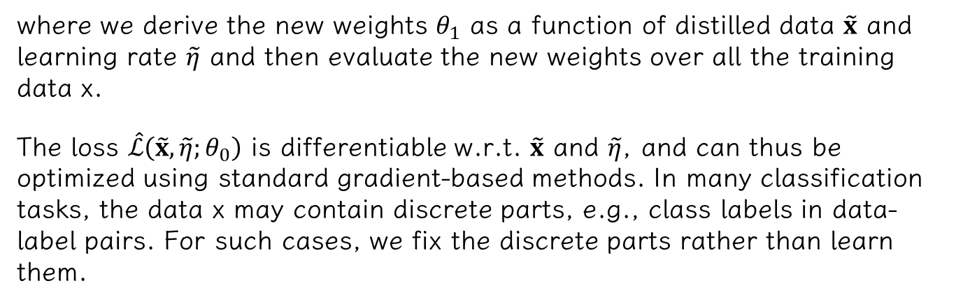
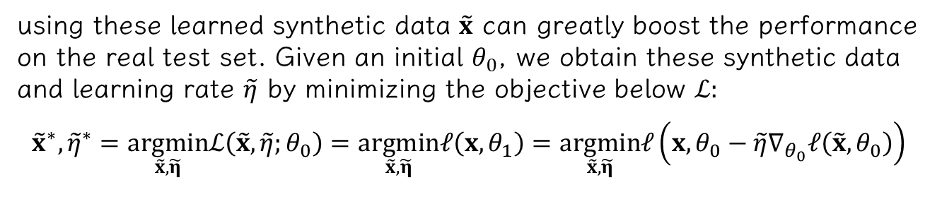
Dataset Distillation
Method
using these learned synthetic data $\tilde{x}$ can greatly boost the performance on the real test set. Given an initial $θ_{0}$, we obtain these synthetic data and learning rate $\tilde{η}$ by minimizing the objective below $ℒ:$
$${\tilde{x}}^{∗},{\tilde{η}}^{∗}=\underset{\tilde{x},\tilde{η}}{argmin}ℒ\left(\tilde{x},\tilde{η};θ_{0}\right)=\underset{\tilde{x},\tilde{η}}{argmin}𝓁\left(x,θ_{1}\right)=\underset{\tilde{x},\tilde{η}}{argmin}𝓁\left(x,θ_{0}−\tilde{η}∇_{θ_{0}}𝓁\left(\tilde{x},θ_{0}\right)\right)$$
where we derive the new weights $θ_{1}$ as a function of distilled data $\tilde{x}$ and learning rate $\tilde{η}$ and then evaluate the new weights over all the training data x.
The loss $\hat{ℒ}\left(\tilde{x},\tilde{η};θ_{0}\right)$ is differentiable w.r.t. $\tilde{x}$ and $\tilde{η}$, and can thus be optimized using standard gradient-based methods. In many classification tasks, the data x may contain discrete parts, e.g., class labels in data-label pairs. For such cases, we fix the discrete parts rather than learn them.

Slide 9
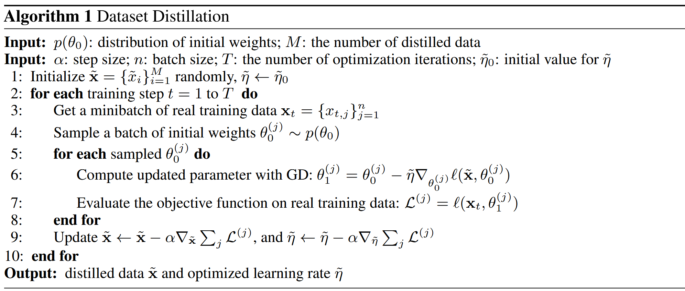

Dataset Distillation
Method
Unfortunately, the above distilled data optimized for a given initialization do not generalize well to other initializations. The distilled data often look like random noise as it encodes the information of both training dataset $x$ and a particular network initialization $θ_{0}.$
To address this issue, we turn to calculate a small number of distilled data that can work for networks with random initializations from a specific distribution. We formulate the optimization problem as follows:
$${\tilde{x}}^{∗},{\tilde{η}}^{∗}=arg\min_{\tilde{x} \tilde{n}}𝔼_{θ_{0}∼p\left(θ_{0}\right)}ℒ\left(\tilde{x},\tilde{η};θ_{0}\right),$$
$$θ_{i+1}=θ_{i}−{\tilde{η}}_{i}∇_{θ_{i}}𝓁\left({\tilde{x}}_{i},θ_{i}\right),$$

Slide 10
Dataset Distillation
Experiment
Random initialization: Distribution over random initial weights, e.g., He Initialization (He et al., 2015) and Xavier Initialization (Glorot & Bengio, 2010) for neural networks.
Fixed initialization: A particular fixed network initialized by the method above.
Random pre-trained weights: Distribution over models pre-trained on other tasks or datasets, e.g., ALEXNET (Krizhevsky et al., 2012) networks trained on ImageNet (Deng et al., 2009).
Fixed pre-trained weights: A particular fixed network pre-trained on other tasks and datasets.

Slide 11
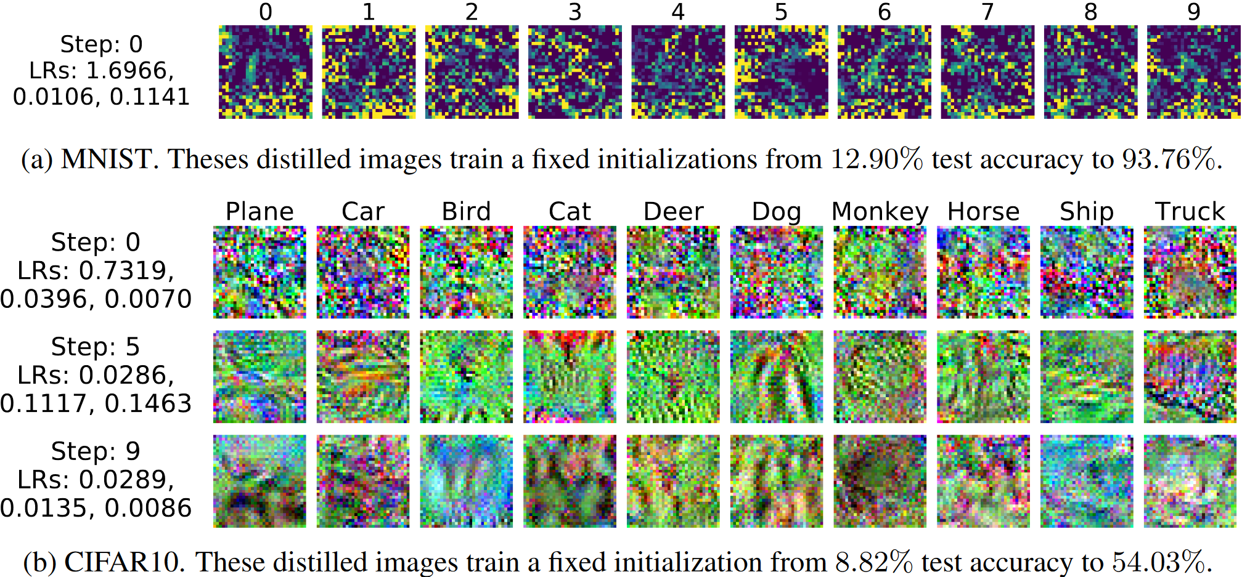
Dataset Distillation
Result

Slide 12
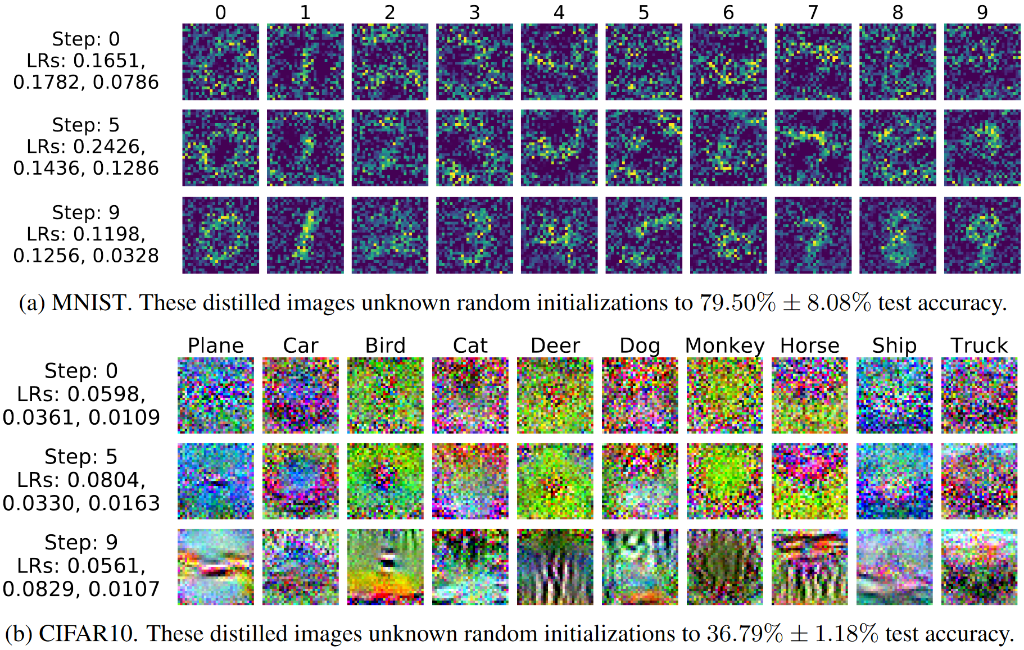
Dataset Distillation
Result

Slide 13
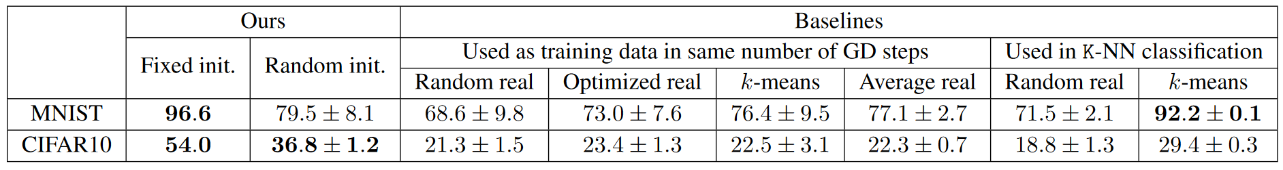
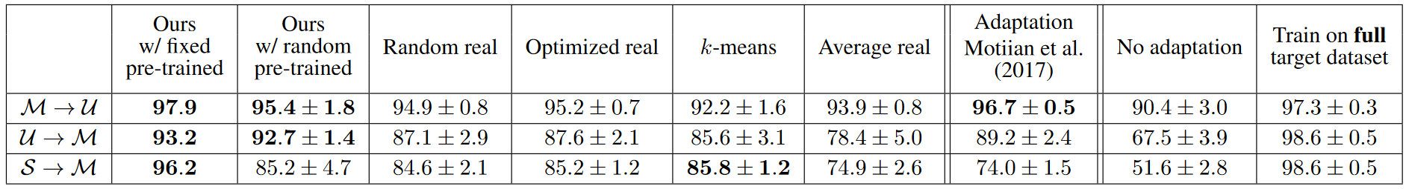
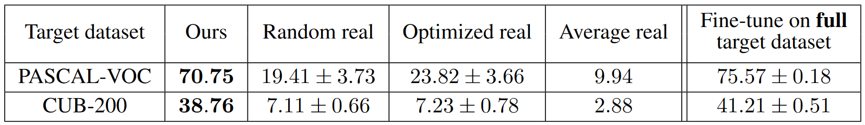
Dataset Distillation
Result

Slide 14


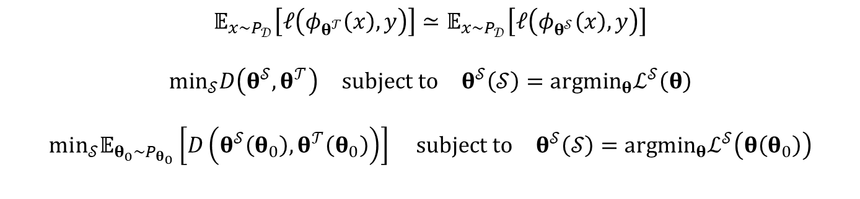
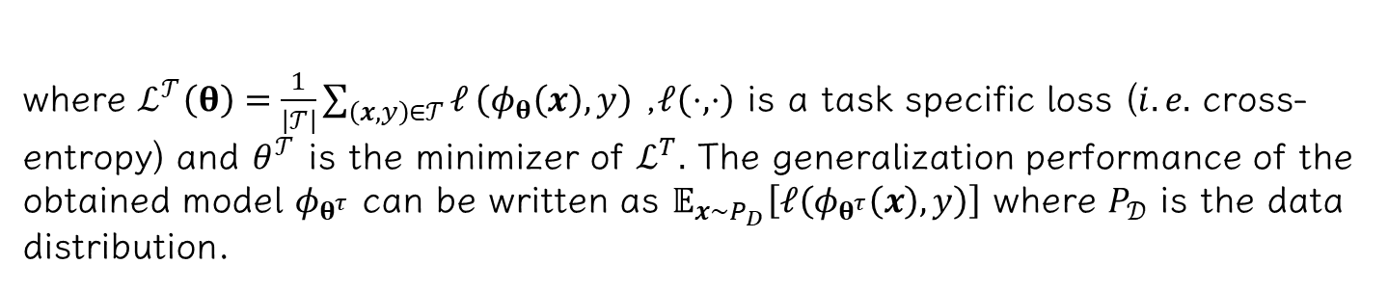
Dataset Condensation with Gradient Matching
Method
$$θ^{𝒯}=\underset{θ}{argmin}ℒ^{𝒯}\left(θ\right)$$
$$θ^{𝒮}=\underset{θ}{argmin}ℒ^{𝒮}\left(θ\right)$$
$$𝒮^{∗}=arg\min_{𝒮}ℒ^{𝒯}\left(θ^{𝒮}\left(𝒮\right)\right) \text{subject} \text{to} θ^{𝒮}\left(𝒮\right)=arg\min_{θ}ℒ^{𝒮}\left(θ\right).$$
where $ℒ^{𝒯}\left(θ\right)=\frac{1}{\left|𝒯\right|}\sum_{\left(x,y\right)∈𝒯}^{​}{𝓁}\left(φ_{θ}\left(x\right),y\right)$ ,$𝓁\left(⋅,⋅\right)$ is a task specific loss ($i.e.$ cross-entropy) and $θ^{𝒯}$ is the minimizer of $ℒ^{T}.$ The generalization performance of the obtained model $φ_{θ^{τ}}$ can be written as $𝔼_{x∼P_{D}}\left[𝓁\left(φ_{θ^{τ}}\left(x\right),y\right)\right]$ where $P_{𝒟}$ is the data distribution.
$$𝔼_{x∼P_{𝒟}}\left[𝓁\left(φ_{θ^{𝒯}}\left(x\right),y\right)\right]≃𝔼_{x∼P_{𝒟}}\left[𝓁\left(φ_{θ^{𝒮}}\left(x\right),y\right)\right]$$
$$\min_{𝒮}D\left(θ^{𝒮},θ^{𝒯}\right) \text{subject} \text{to} θ^{𝒮}\left(𝒮\right)=arg\min_{θ}ℒ^{𝒮}\left(θ\right)$$
$$\min_{𝒮}𝔼_{θ_{0}∼P_{θ_{0}}}\left[D\left(θ^{𝒮}\left(θ_{0}\right),θ^{𝒯}\left(θ_{0}\right)\right)\right] subject to θ^{𝒮}\left(𝒮\right)=arg\min_{θ}ℒ^{𝒮}\left(θ\left(θ_{0}\right)\right)$$

Slide 15
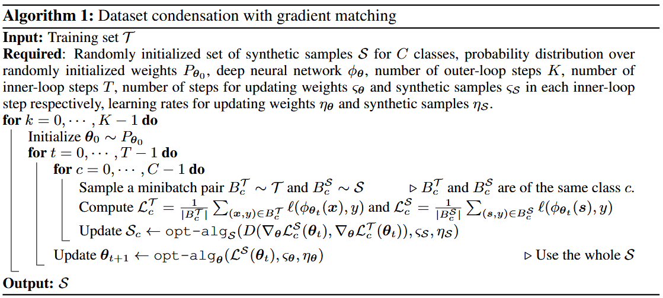
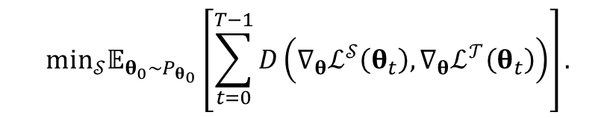
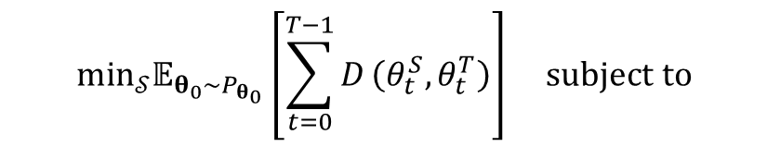
Dataset Condensation with Gradient Matching
Method
$$θ^{𝒮}\left(𝒮\right)={opt_alg}_{θ}\left(ℒ^{𝒮}\left(θ\right),ς\right)$$
The key idea is that we wish $θ^{𝒮}\left(𝒮\right)$ to be close to not only the final $θ^{𝒯}\left(𝒯\right)$ but also to follow a similar path to θT throughout the optimization.
$$\min_{𝒮}𝔼_{θ_{0}∼P_{θ_{0}}}\left[\sum_{t=0}^{T−1}{D}\left(θ_{t}^{S},θ_{t}^{T}\right)\right] subject to$$
$$θ_{t+1}^{𝒮}\left(𝒮\right)={opt_alg}_{θ}\left(ℒ^{𝒮}\left(θ_{t}^{𝒮}\right),ς^{𝒮}\right) and θ_{t+1}^{𝒯}={opt_alg}_{θ}\left(ℒ^{𝒯}\left(θ_{t}^{𝒯}\right),ς^{𝒯}\right)$$
$$\min_{𝒮}𝔼_{θ_{0}∼P_{θ_{0}}}\left[\sum_{t=0}^{T−1}{D}\left(∇_{θ}ℒ^{𝒮}\left(θ_{t}\right),∇_{θ}ℒ^{𝒯}\left(θ_{t}\right)\right)\right].$$

Slide 16
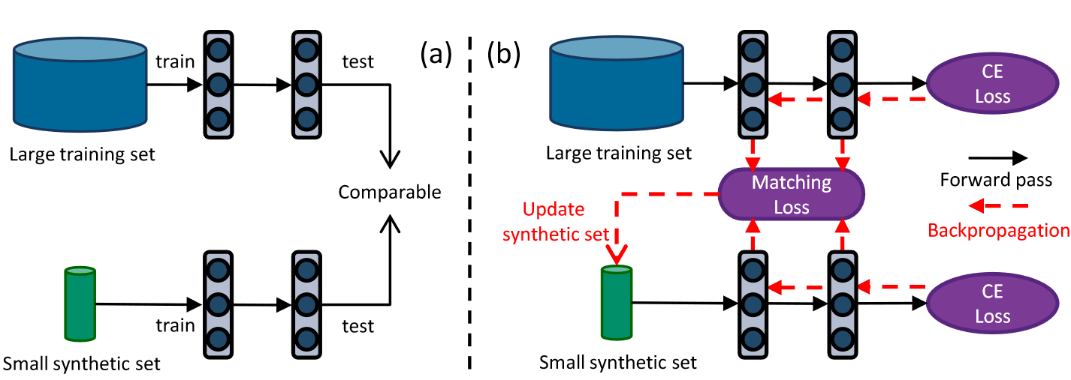
Dataset Condensation with Gradient Matching
Method

Slide 17
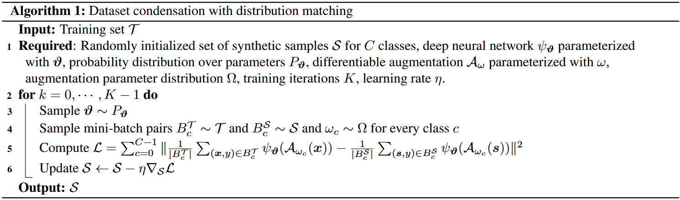
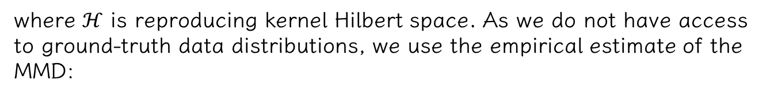
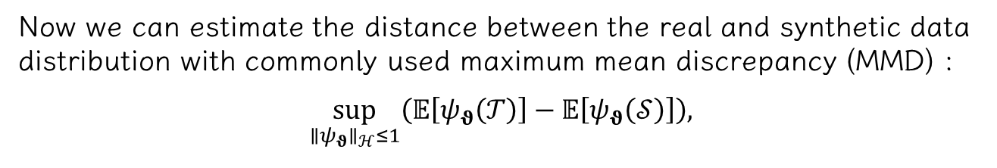

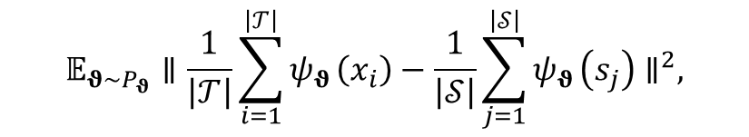
Dataset Condensation with Distribution Matching
Method
Now we can estimate the distance between the real and synthetic data distribution with commonly used maximum mean discrepancy (MMD) :
$$\sup_{∥ψ_{θ}∥_{ℋ}≤1}\left(𝔼\left[ψ_{θ}\left(𝒯\right)\right]−𝔼\left[ψ_{θ}\left(𝒮\right)\right]\right),$$
where $ℋ$ is reproducing kernel Hilbert space. As we do not have access to ground-truth data distributions, we use the empirical estimate of the MMD:
$$𝔼_{θ∼P_{θ}}∥\frac{1}{\left|𝒯\right|}\sum_{i=1}^{\left|𝒯\right|}{ψ_{θ}}\left(x_{i}\right)−\frac{1}{\left|𝒮\right|}\sum_{j=1}^{\left|𝒮\right|}{ψ_{θ}}\left(s_{j}\right)∥^{2},$$
$$\min_{𝒮}𝔼_{θ∼P_{θ}}∥\frac{1}{\left|𝒯\right|}\sum_{i=1}^{\left|𝒯\right|}{ψ_{θ}}\left(𝒜\left(x_{i},ω\right)\right)−\frac{1}{\left|𝒮\right|}\sum_{j=1}^{\left|𝒮\right|}{ψ_{θ}}\left(𝒜\left(s_{j},ω\right)\right)∥^{2}.$$

Slide 18
Conclusion
Insight
1.How to understand the workings of dataset distillation? Or what is the essence of dataset distillation?
2.So far, there are many methods for dataset distillation. How can we effectively adapt and transfer datasets to our own research fields?
Application
1.Currently, there is limited work on dataset distillation in the text domain; more exploration is needed.
2.Combining with other different task types, such as active learning, continual learning, etc.

Slide 19
Dataset Distillation
Thank you for listening!
If you're also interested in this area,
feel free to star:
Guang000/Awesome-Dataset-Distillation: A curated list of awesome papers on dataset distillation and related applications. (github.com)
2024年09月20日 SX2416069 Yangsong Lan
Notes:
任务本身是什么，任务的输入输出，目标是？难点是？

